Slide 1
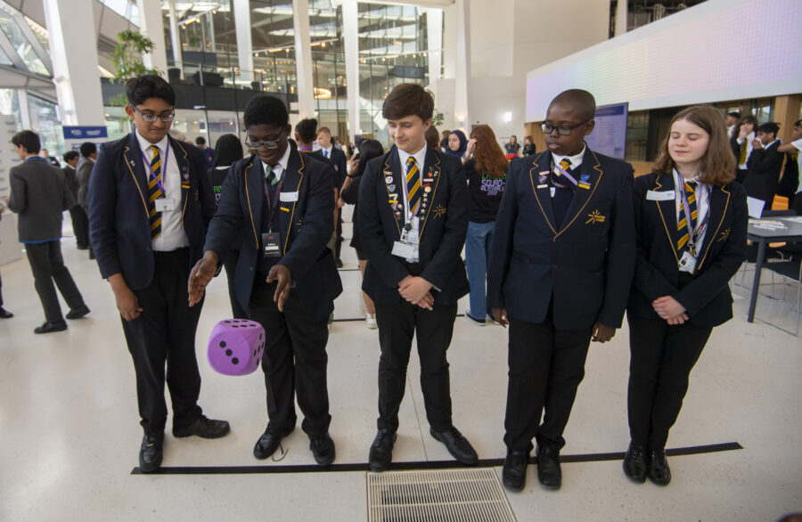
COUNT ON US
SECONDARY CHALLENGE
Chris Olley
chris@themathszone.co.uk
TEACHER TRAINING 2023/4

Slide 2
THE COUNT ON US SECONDARY CHALLENGE
This is the tenth annual challenge for London secondary schools.
Aim: enable many key stage 3 students (100+) to participate in activities providing different and unusual ways to develop curriculum focussed skills: stats and probability, geometry, number and algebra.
May: School teams of 5 compete in F2F heats. (≈12 schools/heat).
(Late) June: Top 12 schools will qualify for the grand final.
100+ students engage with the activities in a challenging and fun environment where they can develop their mathematical skills with the tournament games and activities in the student book.
Five of these students are selected to represent the school in the tournament and these students train hard to be as successful as possible, just as they would for any competitive event.
Notes:
How many could you realistically work with?
What might you do with them?
What would you need to support you?

Slide 3
RESOURCES PROVIDED
Collect after the session (if ordered!):
Sets of GridLines geometry game packs.
Sets of 24®Game packs (of all tournament types).
Large die for Hedgehog play.
Key Documents on the web site:
Student Workbook (PDF) tournament activities and catch up - make available to all students.
Guidance for Schools (PDF) guidance for clubs, class and tournament for teachers and helpers.
Tournament handbook (PDF + PPT + XLS) guide to running your inter or intra school tournament.
Training Videos for all of the activities.
Algebra & Data Rounds practice sets of materials.
www.mayorsfundforlondon.org.uk/our-programmes/count-on-us-secondary
Also look out for this training PPT after the training session!
Notes:
Teacher Guide:
Detailed reminders of everything in the training (note reflections and thoughts, NOT details!)
Student Book:
You will need to make available to ALL students involved in the project (i.e. the 100).
Practice activities for all of the rounds.
All docs only as PDFs on the COU secondary web site (including PPT slides)
Share Browser screen:
Contents screen
Overview: training slides
Getting started: links to activity guidance, all handbooks, training videos
In school tournament: handbook and support materials
Downloads: all in one place!

Slide 4
COUNT ON US CHALLENGE: ACTIVITIES
 | Activity | Description
1a | The Game of Hedgehog (Probability 20 mins) | A simple strategic dice game played teams in a mini tournament.
1b | Data-Chart-Statistics (Statistics ongoing) | A card matching activity played by team members while rounds 2 and 3 are taking place.
2 | GridLines Geometry (Geometry 15 mins) | A geometry card game in which open geometric problem are solved using a random collection of number cards.
3 | The 24®Game (Number 25 minutes) | Make 24 from four numbers. Whole numbers, integers, fractions and decimals, indices and algebra.
4 | Algebraic problem solving (Algebra 25 mins) | A story based problem-solving task involving a lot of algebra and a lot of surprises.
Notes:
Approx. timings from previous in-person events.
The event takes a total of approx. 3 hours.
Online event aims to be similar.
Students get frequent breaks when they are not personally participating and while rounds are set up.

Slide 5
COUNT ON US: IN SCHOOL
Create a page in your notes headed ‘in-school activities’
At each step in this session decide how you will incorporate the activities into school time to maximise the number of students involved.
Have in mind that the tournament is just the cherry on the top!
Where within normal school activity could you incorporate curriculum focussed game and puzzle activities?
Think – pair – share!
Lesson starts and ends.
Sustained class activity – full lesson(s).
After school (breakfast?) clubs.
Take away (homework?)
Etc.
Notes:
Where within normal school activity could you incorporate curriculum focussed game and puzzle activities?
Think – pair – share before showing the list of 5

Slide 6
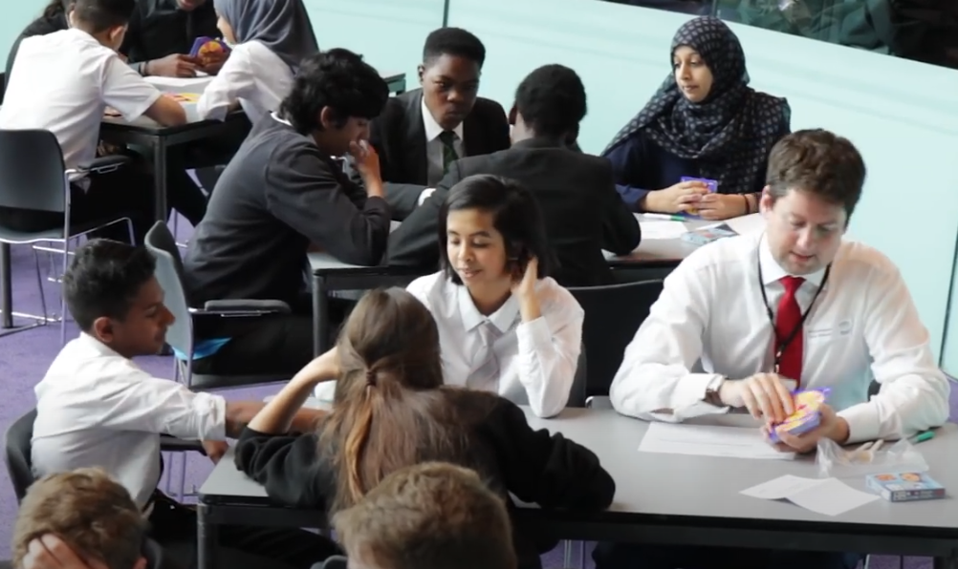
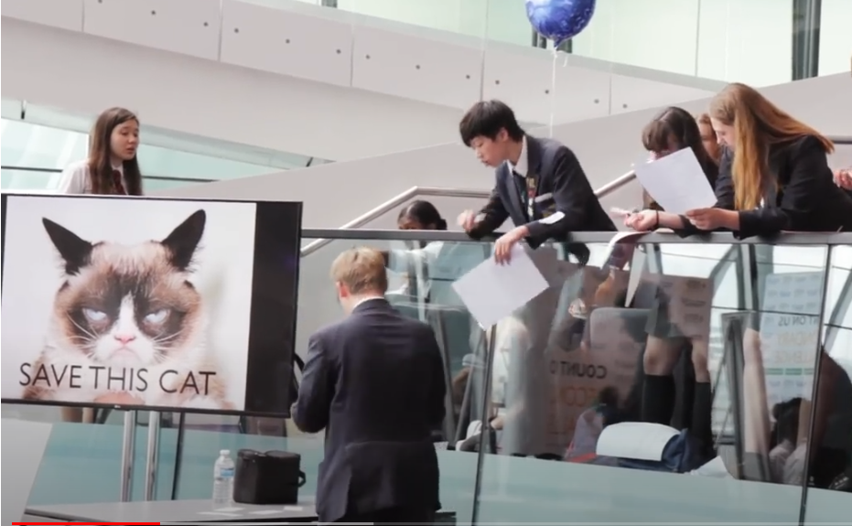
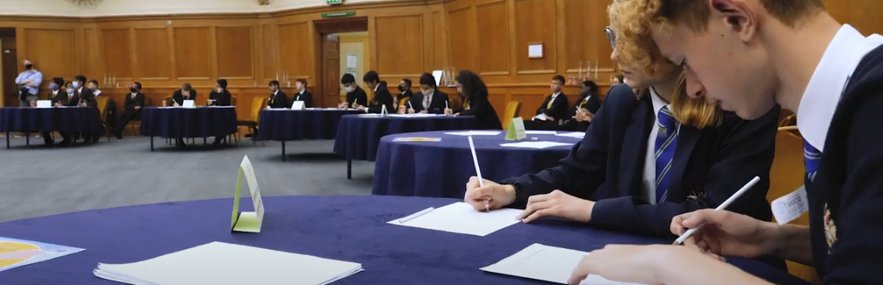
IN/INTRA SCOOL TOURNAMENT
The heats are round two of the tournament. This is round one …
Involve as many of your 100+students … in teams of 5 … in a tournament.
Start planning this from the beginning - book the hall.
Handbook + PPT + Scoring Spreadsheet to help you.
Think of how to bulk out the supplied materials.
Watch the video to hear and see what a tournament looks like.
Greenwich Practice event and March 2024.
How about across the MAT or the borough?
Notes:
1. Bulk out the materials:
Make more dice out of thick card.
Share the gridlines cards – you do not need 5/12 of a set is enough for a tournament!
Increase the number of 24 game cards by teacher know how!
Materials for an Algebra round and D-C-A round are in the tournament guide.
2. People who have done this: share your experiences.

Slide 7
2023 COUNT ON US: CHALLENGE
Be ready to be surprised by who begins to shine in the different aspects of the Challenge.
Look for students who excel at any one of the elements (substitutions are allowed).
Use your practice tournament to see who performs best under pressure!
For returning schools the team must be all students who have not competed before … we keep lists of names!
Schools will be allocated into groups of 12 for face-to-face heats to take place in May.
We will confirm dates as soon as we have confirmed venues.
We expect there will be six heats (more if needed).
The top team in each heat, plus the next 6 highest scoring losers will qualify for a face-to-face final in a central location in late June.
Notes:
If you have a teacher who has done this before on your table, they can share how they chose their teams. If not, where do you think the biggest surprise member of your team might come from?

Slide 8
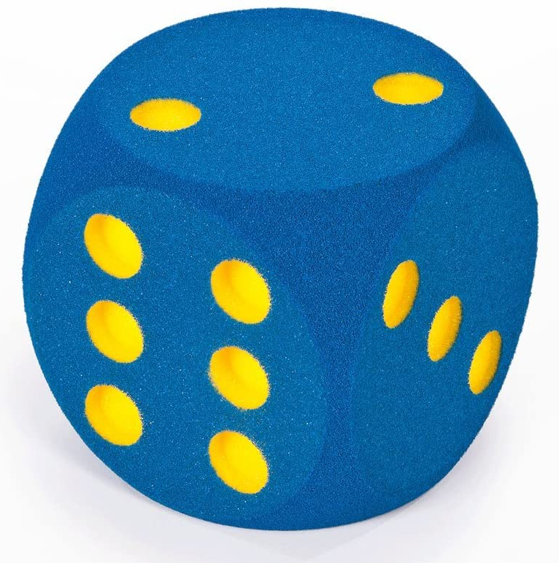
ROUND 1A – THE GAME OF HEDGEHOG
This is a modified version of a classic dice game. The game involves rolling a single die. If you roll 2, 3, 4, 5 you score that many points.
If you roll 1, your turn ends. If you roll a 6 your turn ends but you lose all the points you scored in that turn. Or you can choose to pass, ending the turn without rolling.
The first to score 30 points wins. Teams will line up facing each other with one team assigned to start.
Players in the team play in turn with no communication (verbal or non-verbal) allowed either rolling the die or passing. A judge will keep score.
When one team has scored 30 the final scores are recorded. Points will be awarded according to the scores with a bonus for winning.
Playing Hedgehog: The video
Notes:
[Or wait until after DCA In School slide and do both together]
Two people play a game of Hedgehog, third person keep score. Others watch and ask: would I have done that?
Swap round.
Get two volunteer teams for a spectator game.

Slide 9
HEDGEHOG: IN SCHOOL ACTIVITY
The important things is to consider strategy. There are online simulators for the classic game (the game of Pig) which let you see the probabilities at given points of the game to consider your strategy.
Once students have an idea of the strategy, they can move onto the game of Hedgehog.
Clubs and class: Modify the variables in the game to see how this affects their strategy. Change the penalty for rolling a 6. Change the target score. Change the rules e.g. 1 and 2 end your turn without penalty. Play the two dice game.

Slide 10
ROUND 1B – DATA-CHART-ANALYSIS
Data-Chart-Analysis will be drawn from reporting about real world events or situations. The issue is what data is used to construct a chart illustrating it and what analysis is made from it.
This is complementary to the more direct method of taking small data sets, calculating statistics and drawing charts, common in exams and textbooks.
We will take interesting data sets from any source and ask what sorts of statements you could make using this data and how you could you illustrate this effectively for different purposes.
Clubs and Class … we recommend that students find reports and articles online on issues of interest where data has been used to draw conclusions, illustrated with charts and to look at the relationships between the three components.
Students not involved in GridLines or 24®Game work to match a pack of DCA cards into sets of 3 (6 to 10 sets depending …)

Slide 11
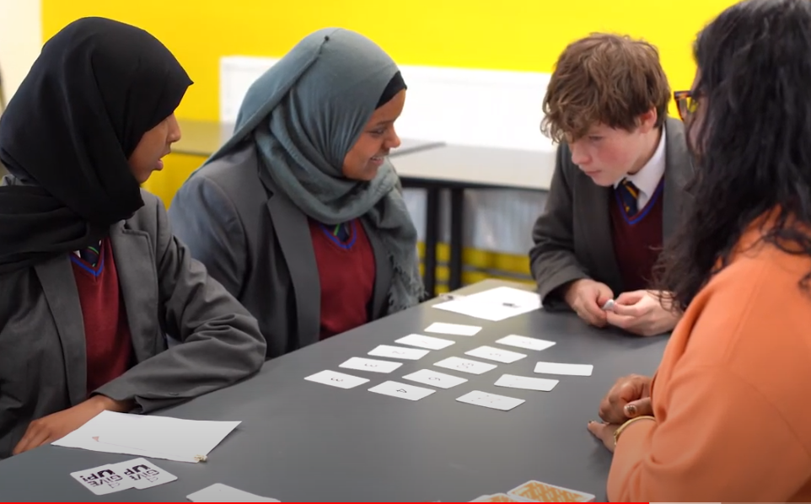
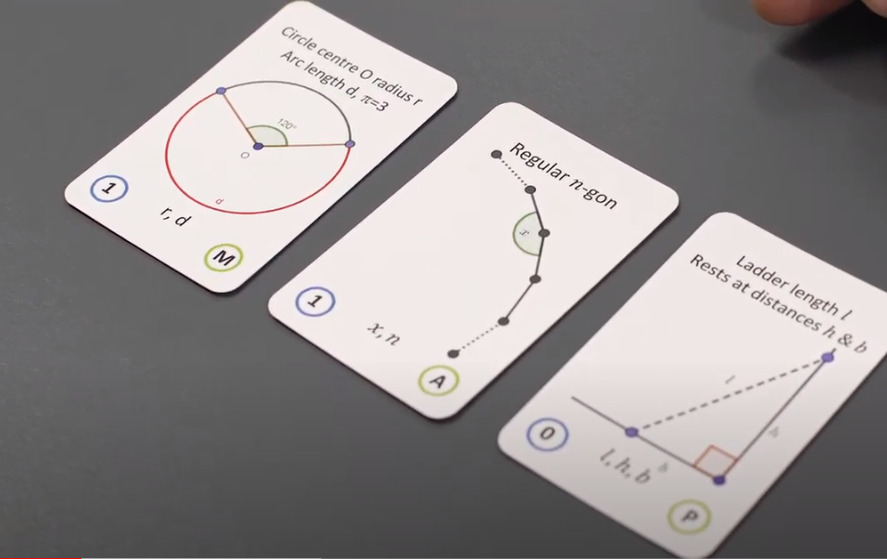
ROUND 2: GRIDLINES GEOMETRY
Gridlines Geometry is a card game designed and made especially for the challenge (by me!)
Cards with geometric problems with variables must be solved using numbers cards.
There are four problem areas: (A) Angle relationships (M) Area and Perimeter (P) Pythagoras (V) Volume and similar figures.
Players see three randomly chosen problem cards and use ten randomly chosen number cards to find solutions.
The game pack contains detailed rules, which are used for normal play and in the challenge.

Slide 12
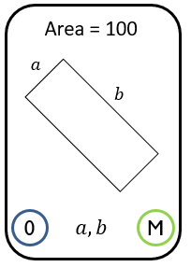
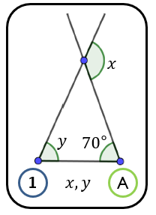
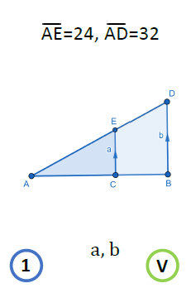
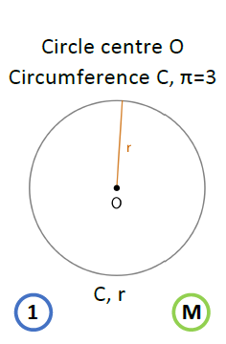
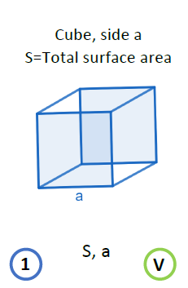
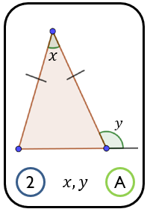
PLAYING GRIDLINES GEOMETRY
Notes:
Pick one, try to find any possible solutions. Try more.
Practice: Find the relationship first. Worry about the numbers later.

Slide 13
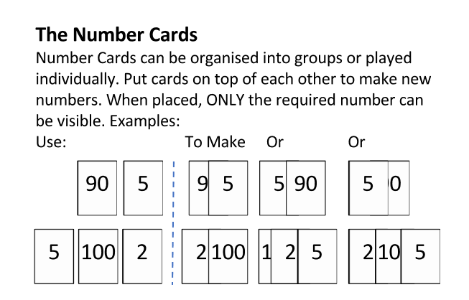
PLAYING GRIDLINES GEOMETRY
Notes:
Practice: know your Pythagorean triples.

Slide 14
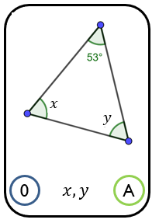
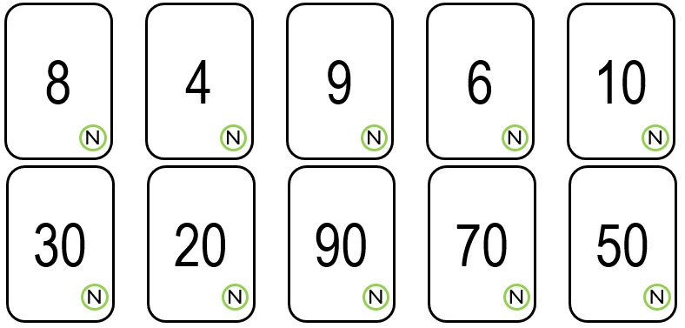
PLAYING GRIDLINES GEOMETRY
$$x+y=180−53=127$$
So, we need to make two numbers with a sum of 127.
Use the 8 and 9 cards to end with 7. So, we need 110 more.
Use 20 and 90 cards to make the 110.

Slide 15
GRIDLINES : HEATS AND FINAL
Three members solve cards together for a continuous 15-minute round.
Solved cards kept by table judge for scoring. Used problem and number cards replaced to keep three/ten in play.
Players have three “I give up” cards. Each allows replacement of any number of problem and/or number cards.
Total score somehow in proportion to difficulty level of cards solved (0/1/2/3).
The 2023 Final was won on exceptional GridLines performance!
Substitutions: as often as you like with only 3 players at the table at a time.
Solutions are shown and explained to a table judge, not written down.
Watch the video after this session.

Slide 16
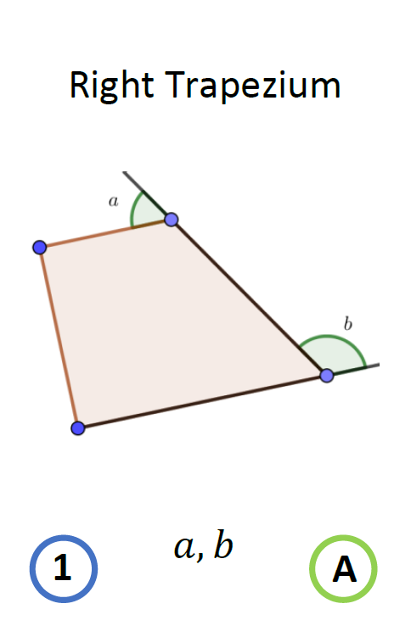
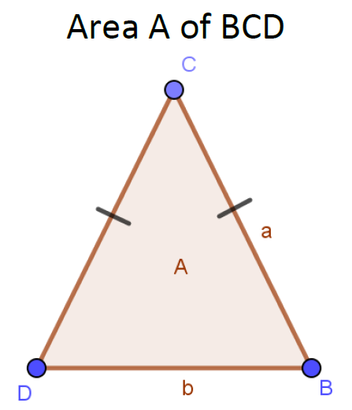
Area A
$$y$$
$$a$$
$135$°
$$a$$
$$b$$
$$x$$
$$a$$
$$A$$
$$b$$
$$b$$
$$x,y$$
$$A,a,b$$
$$a,b$$
0
A
0
M
1
$$x,y$$
A
2
$$A,a,b$$
P
40
4
5
1
2
N
N
N
N
N
3
60
7
100
1
N
N
N
N
N
Notes:
Make teams of 3 (or 2 – NOT 4) on your table.
Find a solution for as many as possible. Yiu can use all ten number cards for each answer.
If you can find one for each find more than one. Jot down how you did it.
Any questions?

Slide 17
GRIDLINES: IN SCHOOL ACTIVITY
Show three problem cards at the start of a lesson. (While you take the register?)
Students find any solution to one of the problems. Explain why it is a solution.
Other students present different solutions.
Discuss how there can be multiple solutions.
Learn Pythagorean triples!
Only use the number cards in club sessions. Then, only after students are confident at finding relationships.

Slide 18
ROUND 3: THE 24® GAME ROUND
The 24® Game is a Card Game
Mentally, combine four numbers using +, −, × or ÷ to make an answer of 24.
ALWAYS 24
The numbers can be one or two digits, they can include negative numbers, fractions or decimals, indices or even algebraic statements.

Slide 19
ROUND 3: THE 24® GAME ROUND

Slide 20
ROUND 3: THE 24® GAME ROUND
Here are two different pairs you can use to make 24.
8 x 3
6 x 4
Notes:
All number point inwards so this is a 6 (9s have the hole filled in red)

Slide 21
ROUND 3: THE 24® GAME ROUND
Find two pairs that you can use to make 24.
8 x 3 8 x 1 = 8 5 - 2 = 3
6 x 4 8 - 2 = 6 5 - 1 = 4
Notes:
Combine two pairs then combine the result. Sometimes you combine 3 and then combine with the fourth.
Then you can very efficiently report the result. Your are strongly encouraged to give your answers in this way.
It is NOT a requirement in the secondary tournament. BUT is in the primary!

Slide 22
ROUND 3: THE 24® GAME ROUND

Slide 23
ROUND 3: THE 24® GAME ROUND

Slide 24
ROUND 3: THE 24® GAME ROUND

Slide 25
THE 24®GAME: HEATS AND FINAL
Format
Five rounds each of 5 minutes
Rules
Hands behind table until card is placed.
Claim with whole hand on card.
Explain immediately but not quickly.
If player correct they take the card. If not judge takes the card.
Giving up rule … (FINAL: NO!)
Substitutions
At end of round 2:
Two players must be replaced.
Scoring
5 Rounds.
7 points for the round winner.
4 points for the round runner up.
1 point for a scoring third place.
Very detailed tournament rules in the handbook!

Slide 26
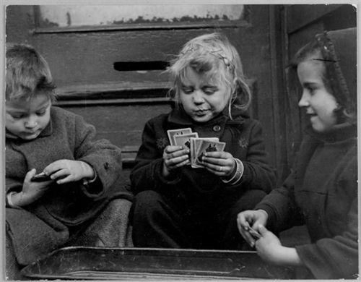
A 24® GAME CHALLENGE
Notes:
Groups of 4: 3 players, one judge. As far as possible do the table rotations.

Slide 27
THE 24®GAME: IN SCHOOL ACTIVITY
Show three problem cards at the start of a lesson. (While you take the register?) Students find solutions and share.
The Student Guide contains various practice activities.
Students can get a 24®Game App for their phones.
Make sure to use all the card types.
To compete, your team must have practised very hard. Some individuals are staggeringly good at this – on one occasion the entire pack was completed in a 5-minute round!

Slide 28
ROUND 4: LESSONS FROM PREVIOUS YEARS
Teams (as a whole) must be able to do all of the algebra listed.
There will be instructions but it will not be clear that they are instructions. For example, listen (and make notes) on what is shown introducing the task.
Follow all instructions.
Share out the work but have a team leader to follow the instructions.
Write down any answers that are found on the answer sheet.
Solve equations carefully and check answers.
No help will be given, so there is no point asking!!
Notes:
Emphasise, speed, concentration.
If it doesn’t work try a different way.
Problem solve!
Tease them that they won’t try!

Slide 29
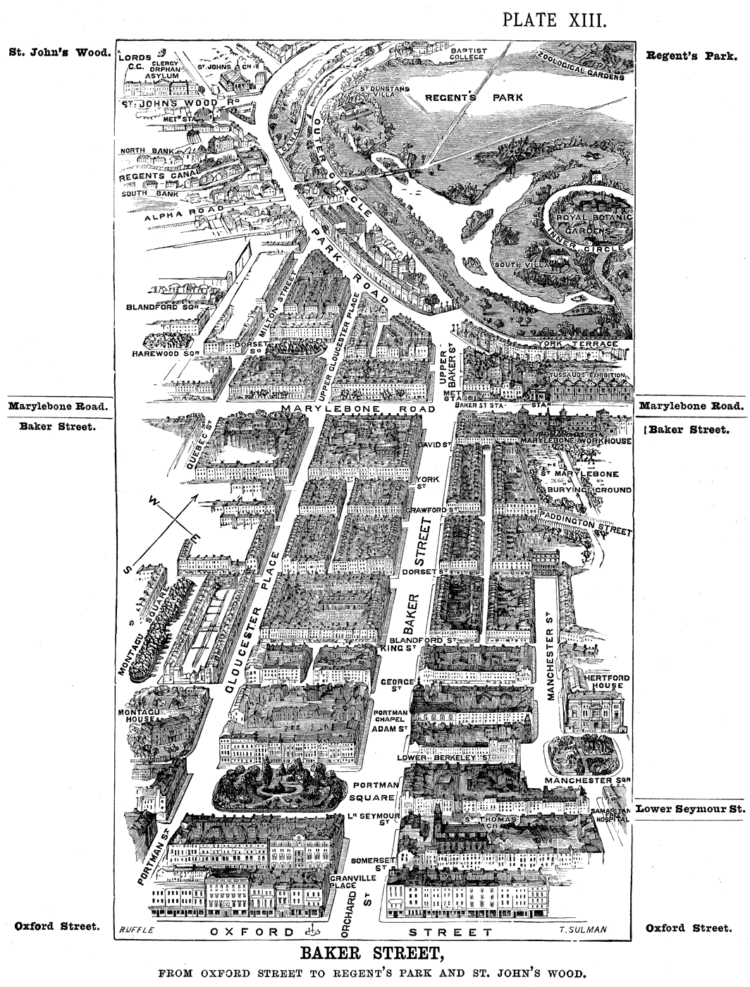
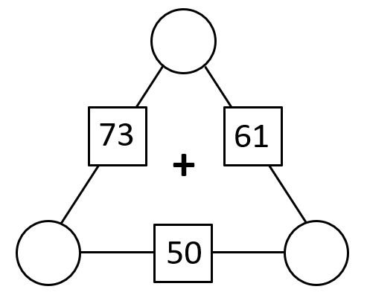
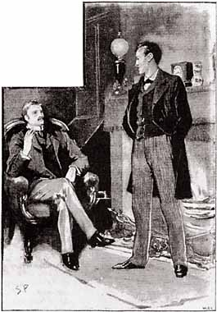
ROUND 4: ALGEBRAIC PROBLEM SOLVING
I say Holmes, should they expected the unexpected?
I should say so, Watson!
The whole team works together to solve a series of problems set in a story context – with video, audio, props ...
Students will need to use algebra of any type included in the National Curriculum (a complete list is in the handbook). Notably this now includes linear graphs: including co-ordinates and drawing and reading from graphs given in some form of $y=mx+c$
Teams may have to solve additional unannounced problems.
Teams must read everything they are given & look out and listen for anything else they might need.
Any instructions found must be followed carefully.
If there is an answer sheet, it must be used.

Slide 30
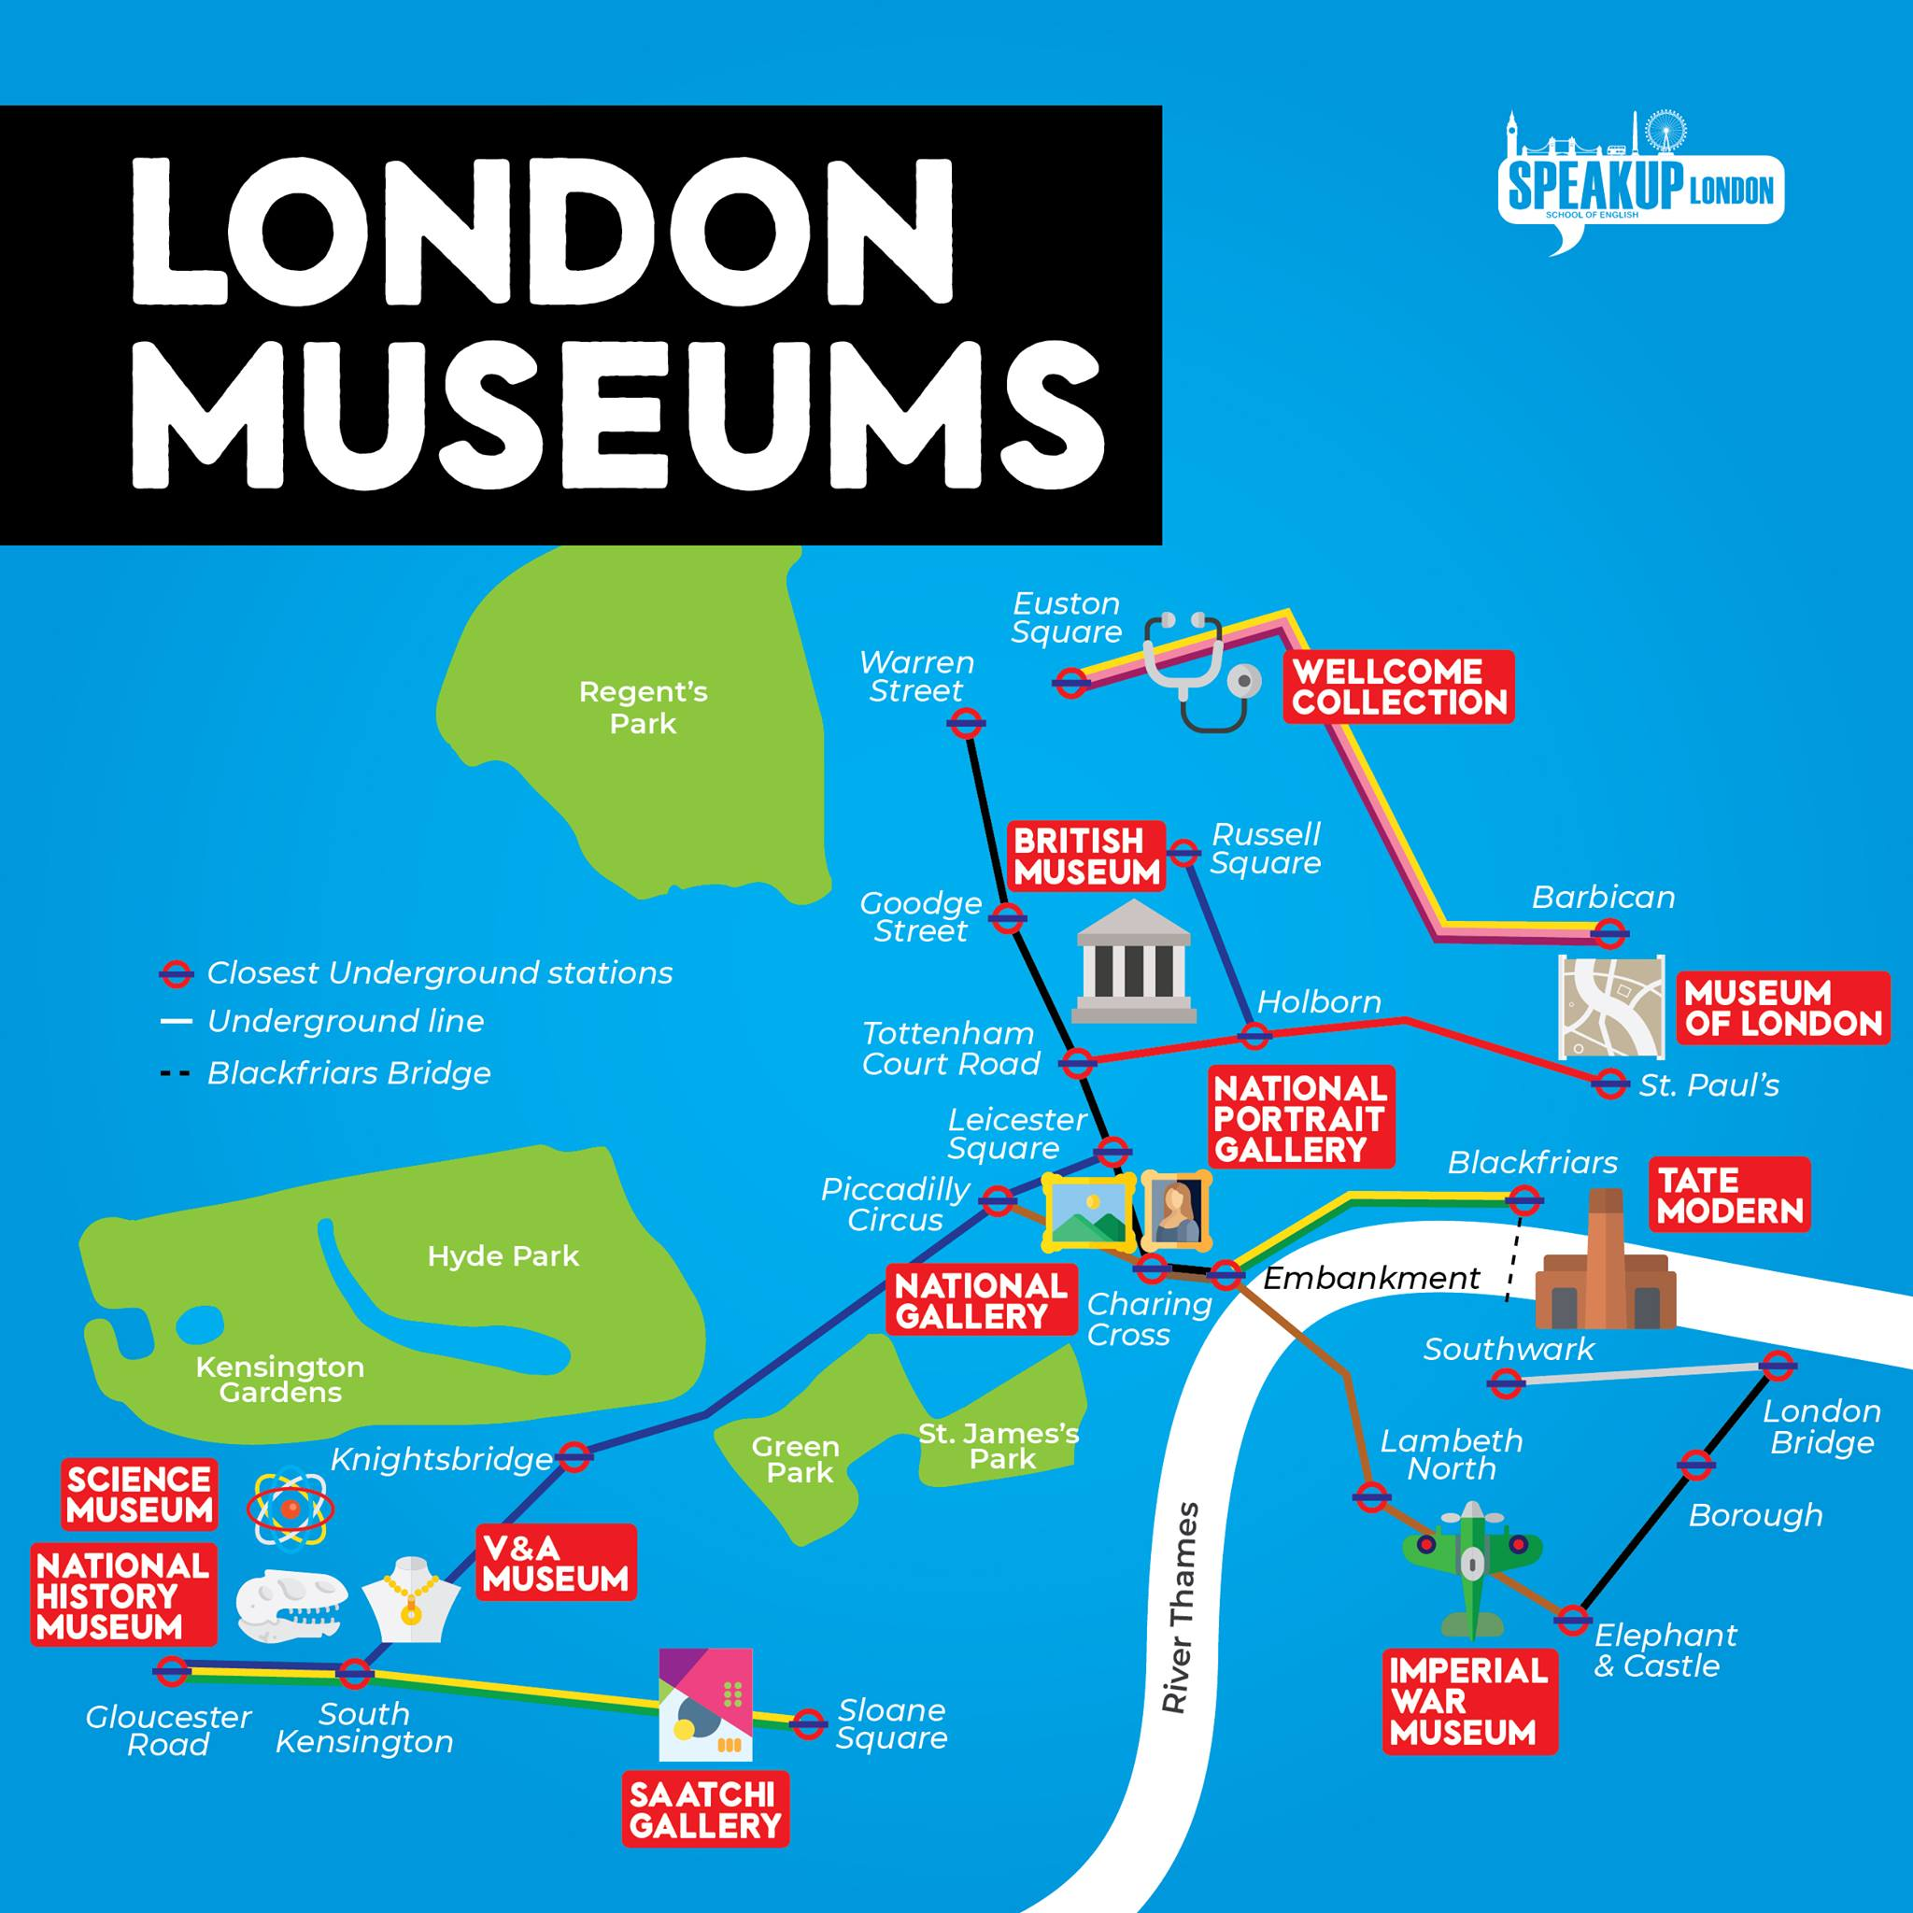
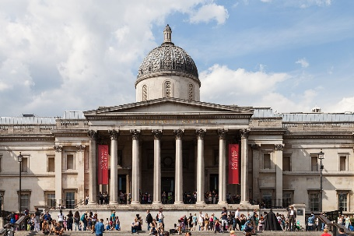
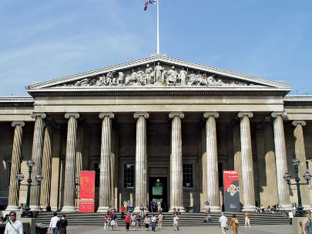
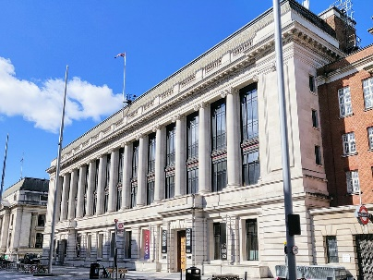
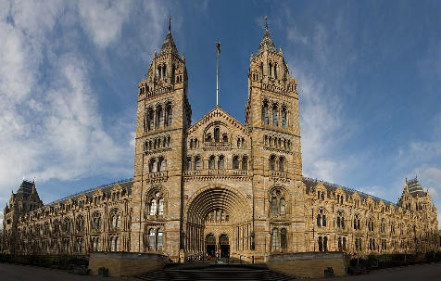
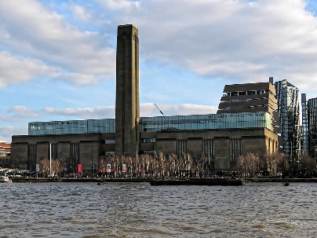
ONE Person from each group can come out and collect ONE map and ONE data sheet from the front table.
Notes:
London’s great Museums and galleries need young people to act as ambassadors to show what amazing places they are and what great stuff they have.
So, you must be able to answer questions about them and their most celebrated artifacts.
We will supply you with a data table fact sheet to collect your information and a map showing where they are.
Complete the table and bring it to me. There will be a bonus early finishers but only if you are at least 90% correct and everything is completed. GO TO NEXT SLIDE

Slide 31
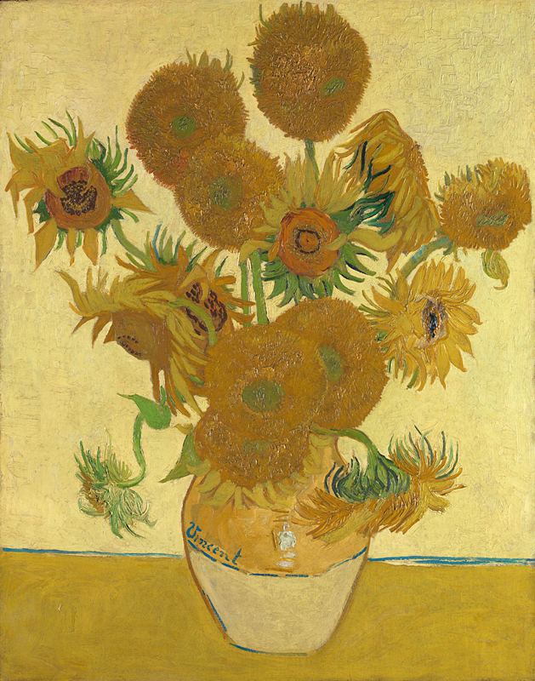
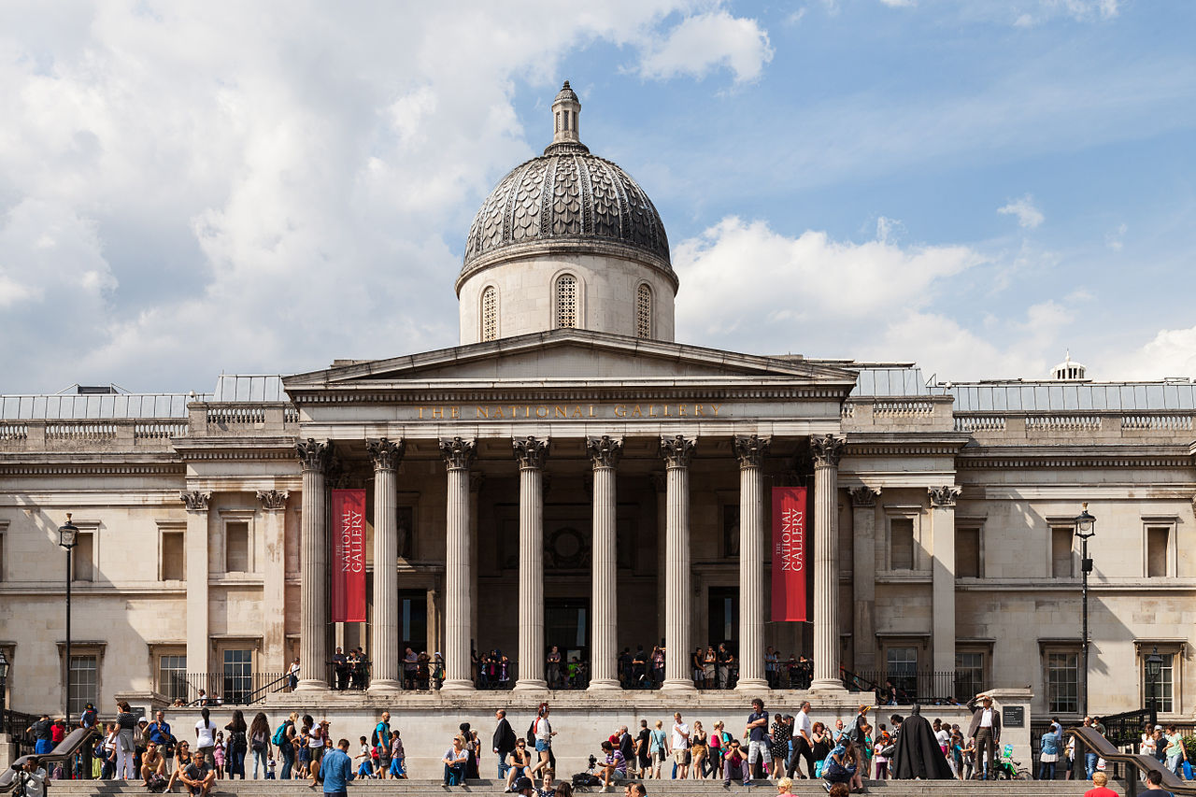
The National Gallery in London’s Trafalgar Square. Opened in 1824, home of Vincent Van Gogh’s paining ‘Sunflowers’.
Notes:
STAY ON THIS SLIDE UNTIL 4 Minutes (BANDAGE)

Slide 32
Collect your next information sheet …
Write the value of $x$on a piece of paper.
Show it to the museums’ director discretely.
Queue nicely and quietly if necessary.
$$x=\frac{A^{2}+12B−C }{D}$$
Where $A=14 B=11 C=28 D=3$
Notes:
Answer x=100
Move On on 10 Minutes

Slide 33
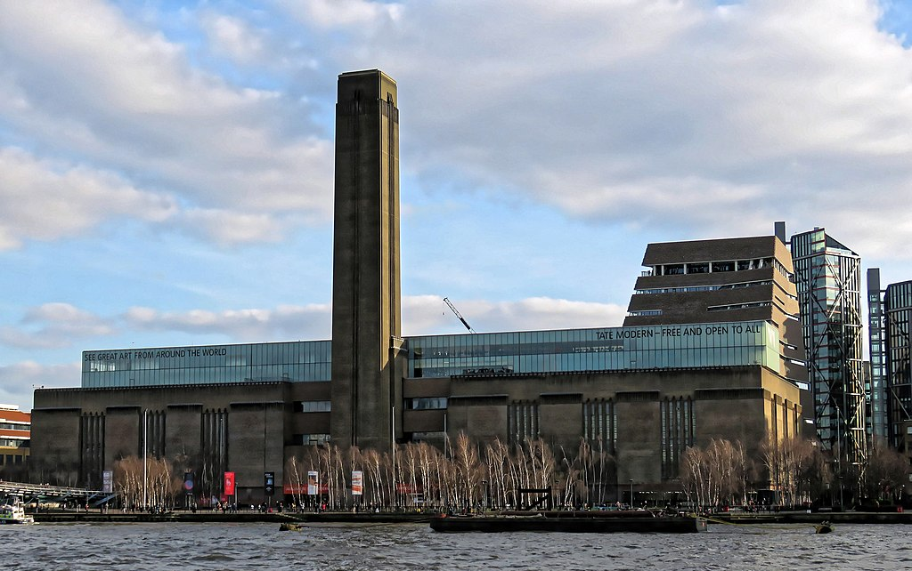
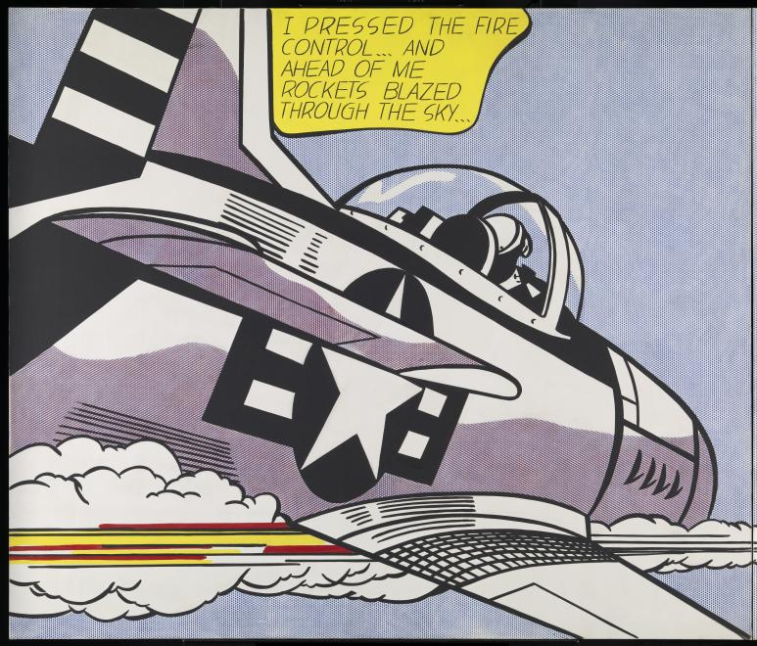
URGENT POLICE REPORT
Vincent Van Gogh’s painting has been stolen in a daring raid. Initial reports suggest it has been taken to a place on the line $y=2x+4$ where $x=−3$
Roy Lichtenstein’s 1963
The Tate Modern Gallery on London’s Bankside.
Notes:
Move On on 7 Minutes

Slide 34
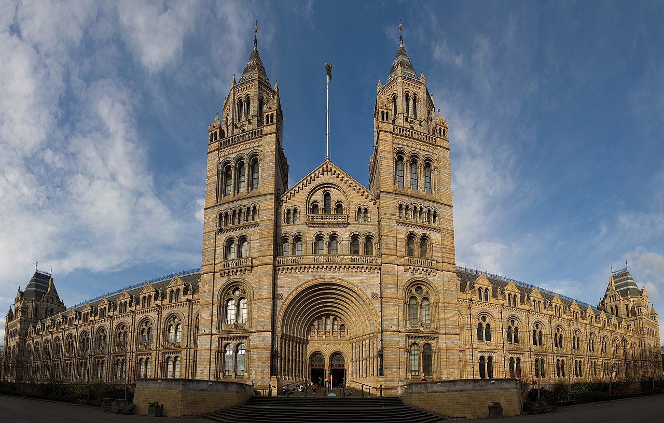
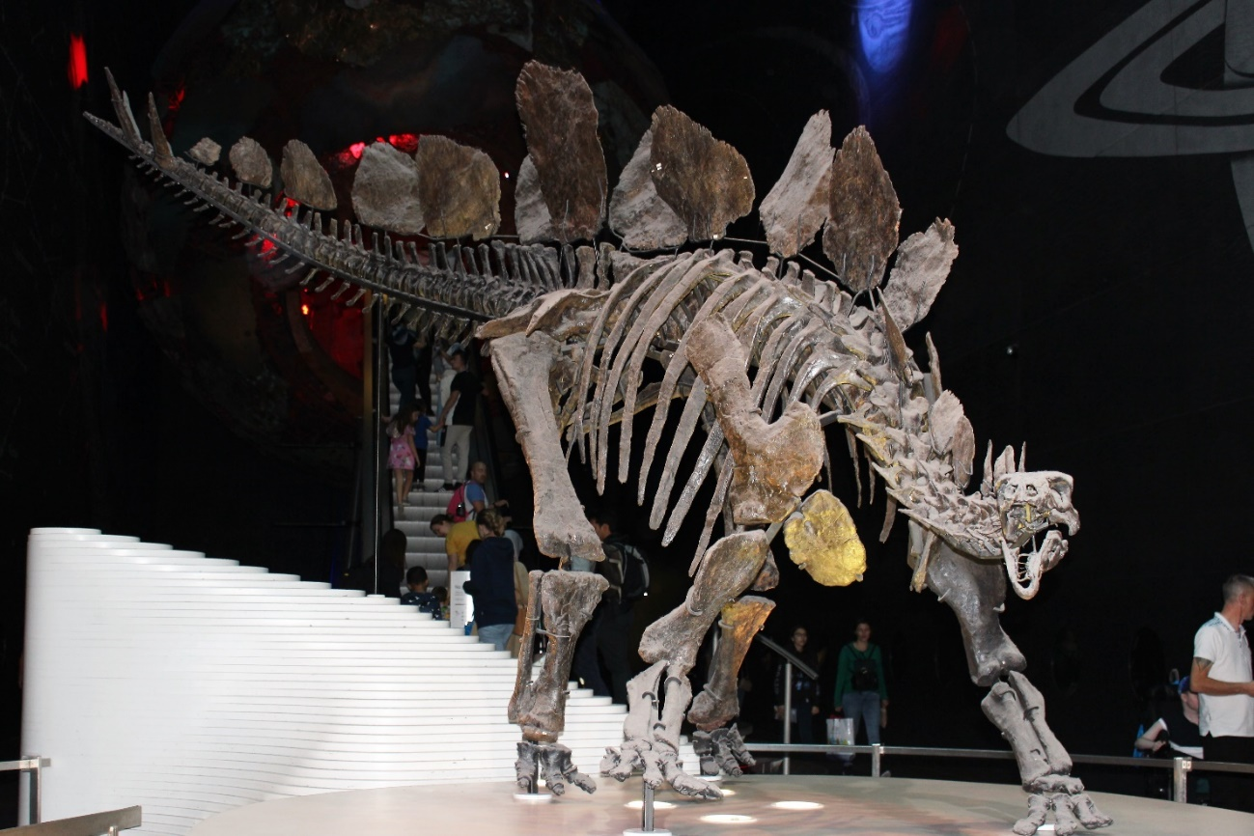
URGENT POLICE REPORT
Vincent Van Gogh’s painting Sunflowers has been taken to a place on the line $y=2x+4$ where $x=−3$
1.5x10⁸ BCE
The Natural History Museum in West Kensington. This dinosaur was found by Paleontologist Bob Simon.
Notes:
Move On on 13 Minutes

Slide 35
Collect your next information sheet …
Write the key word on a piece of paper.
Show it to the museums’ director discretely.
Queue nicely and quietly if necessary.
A=1, B=2, C=3 etc.
$2^{3}$ $3^{2}$ $5^{2}−6$ $\frac{7^{2}−9}{2}$ $\frac{9^{2}+9 }{6}$ $\frac{6^{2}}{2}$ $\frac{{10}^{2}}{4}$
Notes:
Answer is ‘History’
Move On on 16 Minutes

Slide 36
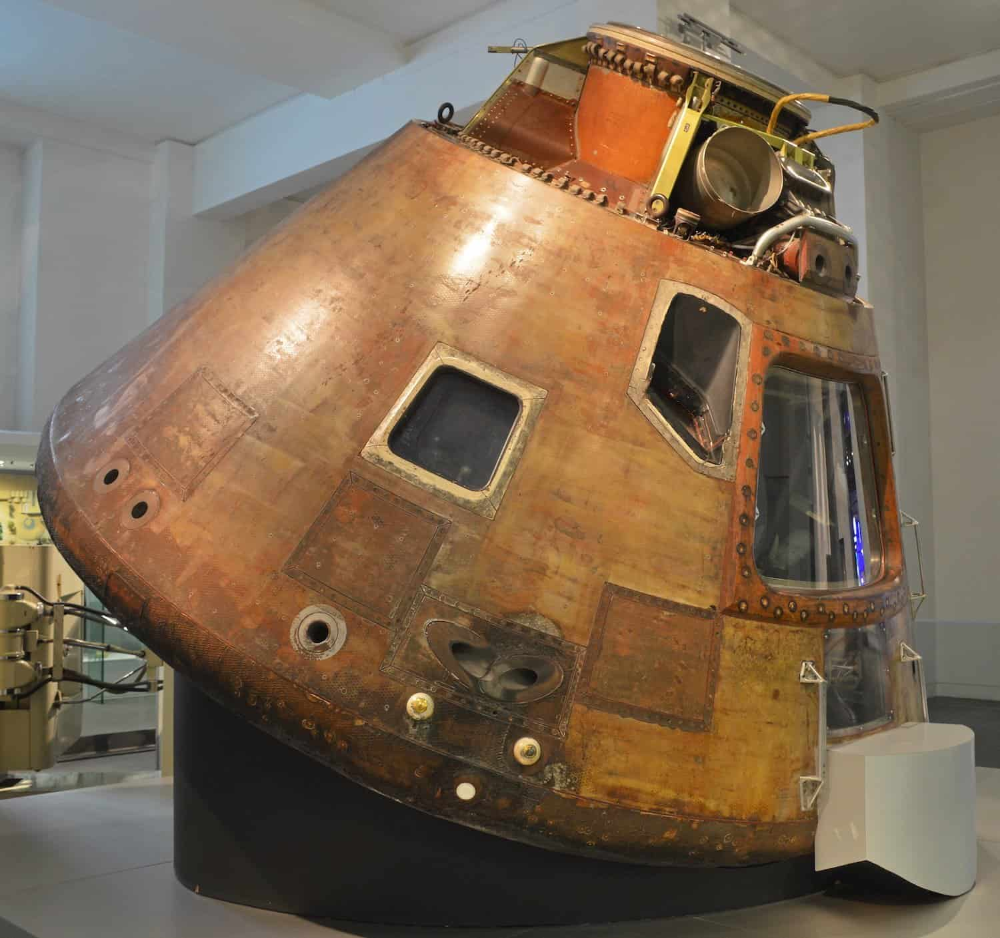
URGENT POLICE REPORT
Vincent Van Gogh’s painting Sunflowers has been taken to a place on the line $y=2x+4$ where $x=−3$
Apollo 10 Command Module
The Science Museum opened in 1857.
Notes:
Move On on 19 Minutes

Slide 37
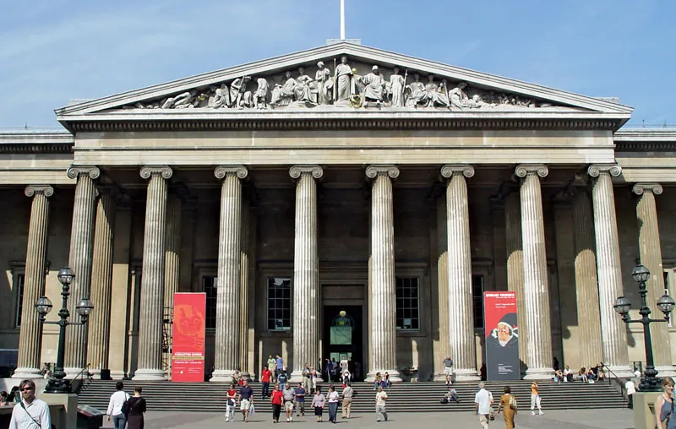
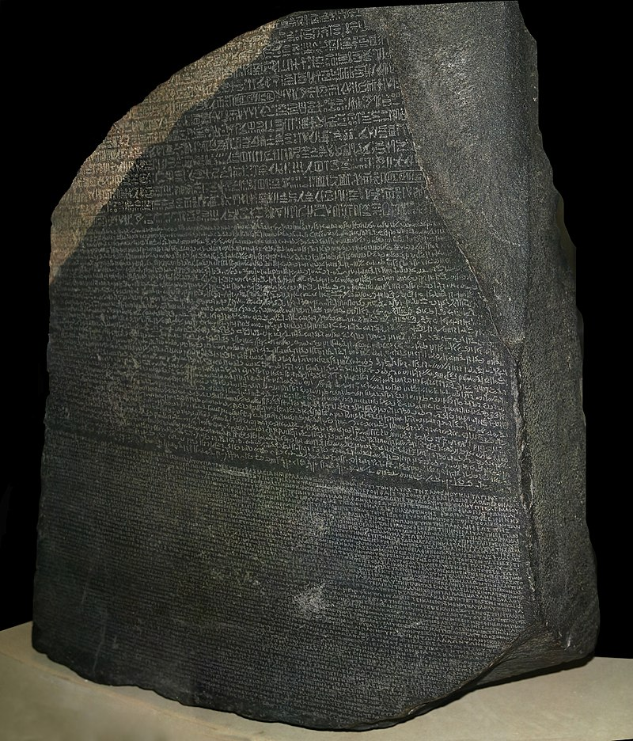
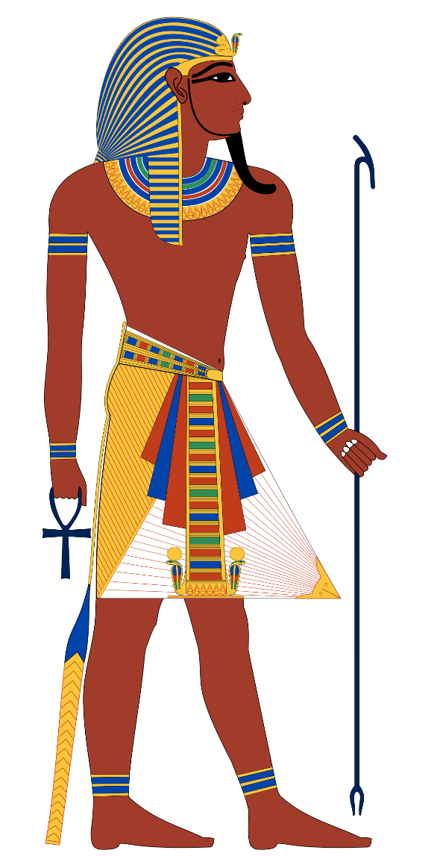
I am King Ptolemy V and I brought this stone into being
196 BCE
The British Museum, opened in 1753, houses a stone used to translate Egyptian Hieroglyphs.
Notes:
Move On on 22 Minutes

Slide 38
The first complete, all correct fact sheet brought to me will win a warm glow of contentment.

Slide 39
Q+A
In your table group ask any burning issues. Go round and give everyone a turn!
All attempt to give a solution to each issue.
Write down the one most important unsolved issue to ask me.

Slide 40
GOOD LUCK!
The most important thing is that the largest number of students get the chance to have fun engaging with the maths and get better in their maths by doing so …
… then a small group reach an elite level and represent your school and they have fun taking part.

